Slide 1
Sib Rs → Discrete & central role
Most . (NORC, 1998)
(Riggio, 2000)
Influence distinct from other fam mmbers
ID format. = (Weaver et al., 2003)
Approx. Americans → @ least 1/3 of lives w/ sibs (Fitzpatrick & Badzinski, 1994)
STILL understudied!!? ( of family & IP res; Floyd & Morman, 2006)
Notes:
Weaver, Coleman, & Ganong, 2003

Slide 2
Ways Sib Rs Unique (Deater-Deckard et al., 2002)
Highly interdependent!
(Segrin & Flora, 2005)
Nearly constant socializing agents
Share
(hierarch. Interaxns like teaching/caretaking)
(equal, mutual interaxns like play/conflict)
of companionship & support
Also source of
Intense emotionality
Adults can end “active” R but doesn’t dissolve sib status (Mikkelson, 2006)
Notes:
Deater-Deckard, Dunn, & Lussier, 2002

Slide 3
Types
Identical twins
Fraternal twins
Full sibs
Half sibs
Step-sibs
Adopted sibs

Slide 4
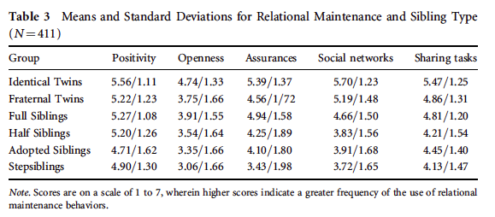
R Mainten. Behav’s (Mikkelson et al., 2011)

Slide 5
Common “issues”?
Differential parenting?
Roles
https://www.facebook.com/video.php?v=10152637025366308&fref=nf
Birth order→
Rivalry

Slide 6
Sibling Abuse
In Straus & Gelles (1988) study…
hit sib
severe viol
2/3 (ages 15-17) assault sib @ least 1x
Diff. b/w abusive behav. & abusive Rs

Slide 7
How to Tell… Rivalry or Abuse?
Behav. age-approp?
How often & long has behav. occurred?
Aspect of victimizat. in behav?
Purpose of behav?
Any “standard signs” can indicate sib abuse

Slide 8
The Sibling Bond
https://www.ted.com/talks/jeffrey_kluger_the_sibling_bond

