Slide 1
To Know from Coontz (2000)
Reason for initial historical “decline” of extended kinship
Myths regarding:
“Affective individualism” & family Rs
Time spent with children
Nuclear or other “ideal” structures
Aspects of family economy:
Sources of resource-attainment
Different ways resources are distributed within families
Various expectations of roles for children
Pros vs. Cons of marriage/family life vs. single
Importance of context when studying families

Slide 2
Lineage emphases
Greek “families” among
Judeo-Christian
Roman
Dynasties (Assyria, Egypt, China)
Totem Poles (indigenous peoples)
European “ancestries”
U.S. mandated recording (christenings, marriages, burials) in 1632

Slide 3
Historical Record
Upper class bias (e.g., nobles, wars, empires)
1st study “ordinary” families 1960

Slide 4
Primacy of Public Families (U.S.-Euro colonies)
Performed public services (education, health, jail)
No privacy
All was public business
Houses lacked
Diverse structures
Marriage often unofficial

Slide 5
19th Century Families

Slide 6
Rise of “Private” Family (1900-1990s)
Early Decades:
Increase in :
Decline in:
Family dominance in people’s lives
Emphases on:
Family as source of

Slide 7
Recent distinct “group” trends
Great Depression Generation
Family finances
Father-authority
Divorce-rate
Marriage & childbearing
Children help/work
Baby Boom Generation
Renewed focus
“Highpoint” of breadwinner-homemaker “model”
Not really “traditional family”
Faded quickly
1960s-Beyond
Birthrate
Married
Divorce-rate doubles 1960s–70s
Emergence of
Children delayed

Slide 8
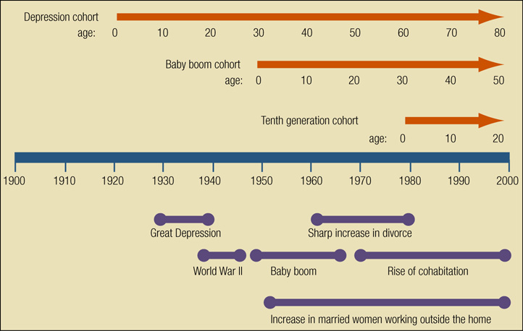
Life-course perspective on 20th century social change

Slide 9
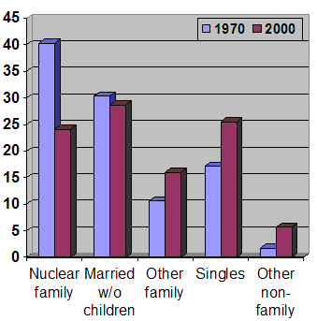
Notes:
Graph created by User:BrendelSignature using US Census Bureau data published in the sociology book, Marriages, Families & Intimate Relationships by Brian K. Williams, Stacey C. Sawyer, and Carl M. Wahlstrom. Published by Pearson in 2006.

Slide 10
Transition over time…
“F”amily
Based on
To…
“f”amily
More
Voluntary, based

Slide 11
Myths Activity
2 things you thought (before today’s lecture) about families in history that were “wrong”
2 things you think are the SAME in the 2010s as in the past
2 things you think are DIFFERENT in the 2010s compared to past

