Slide 1
Verbal Communication
Denotative Meaning
Connotative Meaning

Slide 2
Levels of Abstraction
  Concrete
  Abstract

Slide 3
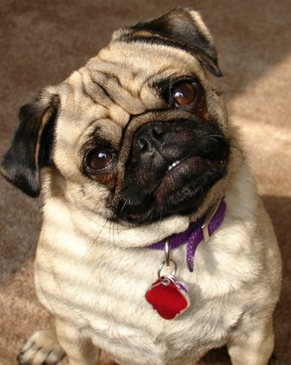
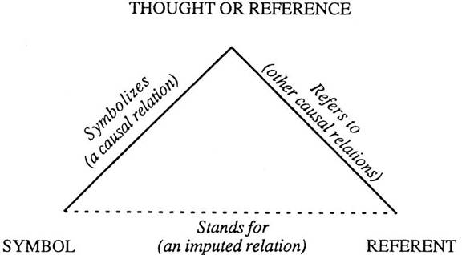
Triangle of Meaning
Small animal I possess & love
“Pet”

Slide 4
Types of Language
Idioms
Phatic comm.
Tag endings
Specific Pronouns

